Slide 1
07-01- Overview of Application Software - Databases
Purpose
Concepts
Types
Functions
Advantages
Disadvantages

Slide 2
Section Goal(s)
Understand Database concepts and types
Understand the purpose and functions of Databases
Understand advantages and disadvantages of Databases

Slide 3
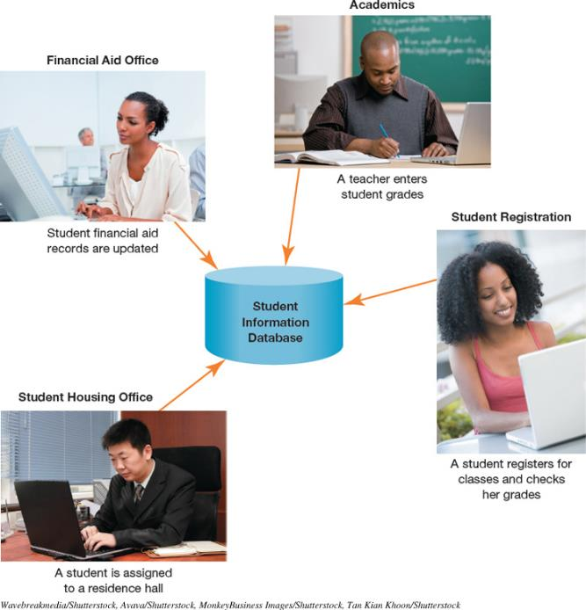
Database Purpose
The purpose of a database is to help your business stay organized and keep information easily accessible, so that you can use it.

Slide 4
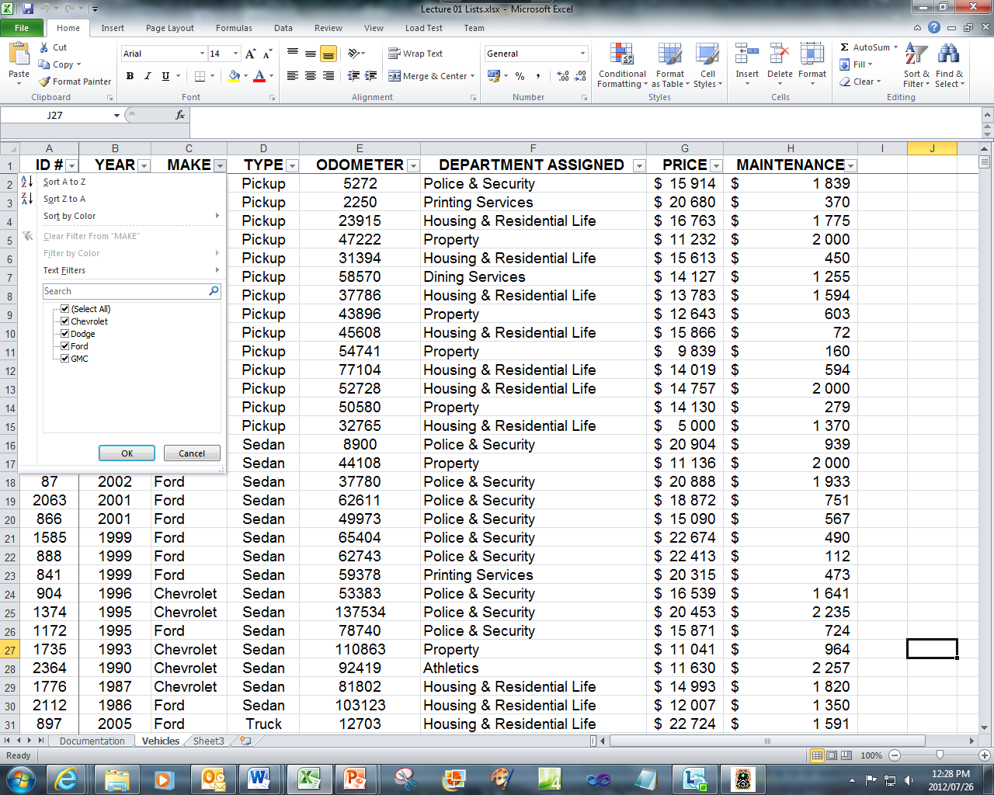
Database Concepts
Using Excel List Tables made it easy to
  Store information
  Filter according to criteria
  Sort information
  Display totals
Using List Tables can lead to inefficiencies due to repetition of data and errors from inconsistently entered or updated data.
A Database is a collection of related data, which can be
  Stored
  Sorted
  Organized
  Queried

Slide 5
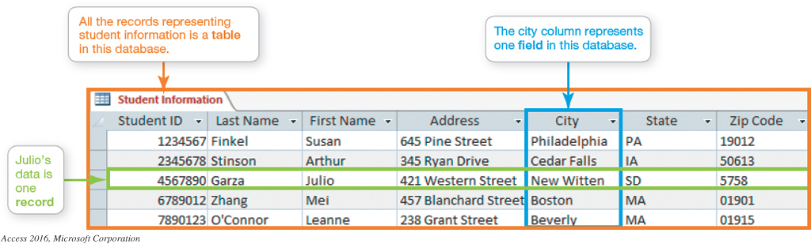
Database Concepts
The collection of data is organized into
  Fields – Fields are displayed in columns and each field is identified by a field name
  Record – Is a group of related fields and displayed in rows
  Table(Files) – A group of related records

Slide 6
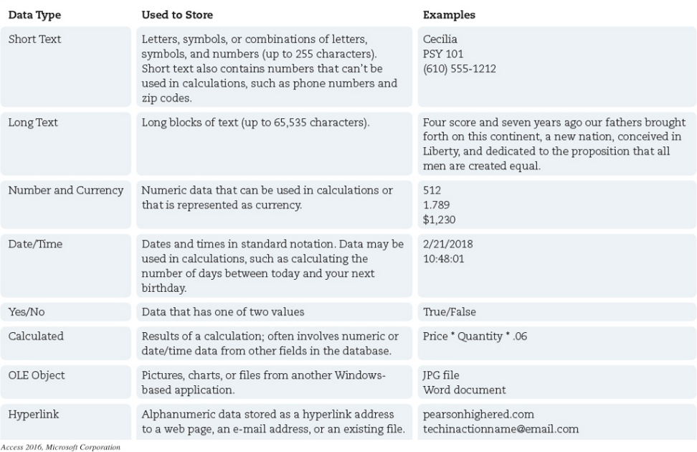
Database Concepts
Data types of each field show what kind of data can be stored in the field
Notes:
Data (field) types indicate what kind of data stored in the field.

Slide 7
Database Concepts
Field properties help to define the field data, there are three common field properties
  Field size -is the maximum number of characters a field can hold
  Default value is what is used unless the user enters another value
  Caption enables you to display the field name in a more meaningful or readable manner

Slide 8
Database Concepts
Using Primary Keys
  Primary key – is a field in the table which uniquely identifies a record
  Foreign key – in related (linked) tables, the common field linked to a primary key in one table is called the foreign key in the linked table
  Referential integrity ensures that relationships between tables remain constant and the quality of the data is guaranteed in the database

Slide 9
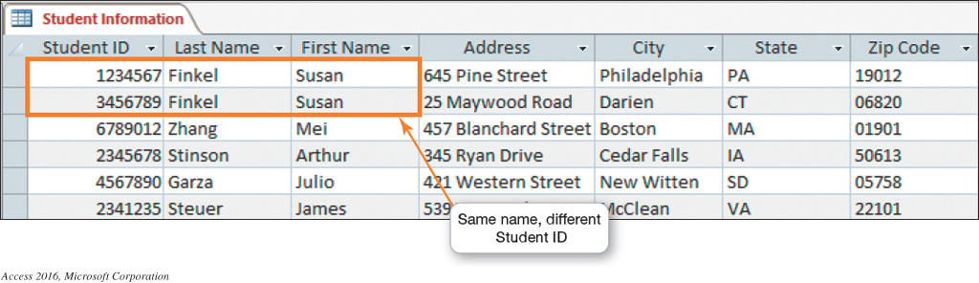
Database Concepts
The StudentID field is a good primary key field because even students with the same name will not have the same ID number (unique).

Slide 10
Database Concepts
Data validation ensures that only valid data is entered in a field
Viewing and Sorting Data allows you to display and reorder data
Extracting or Querying Data
  Use a filter
  Use a query
The most common form of output for Databases is viewable or a report

Slide 11
Database Types
Relational databases (Access)
Organizes data in table format
Logically groups similar data into a relationship
Common field in one table linked to common field in second table (Foreign key)
  Three types of relationships can be created
  One-to-many
  One-to-one
  Many-to-many
Object-oriented database (take note only)
Multidimensional databases (take note only)

Slide 12
Database Functions using an example
Example: Charity fundraisers
A local company manages fund-raising projects for different charities. They need a database with information about contributors and their pledge amounts.
Charities
Contributors
Pledges: Different amounts promised by specific contributors for specific charities.
Charities
Contributors
Pledges

Slide 13
Database Functions using an example
Example: Charity fundraisers
For each Charity and Contributor certain information must be stored (e.g. Name of Charity, Name and phone number of Contributor)
For each Pledge it is important to be able to identify: Charity and Contributor, as well as the amount pledged
Every Charity, Contributor and Pledge must be uniquely identifiable
Charities
Contributors
Pledges

Slide 14
Database Functions using an example
Table relationships
Join tables on a common field
  Primary vs. Related table
Explains how tables are linked, e.g.
  Each charity can have many contributors
  Each contributor can make many pledges.
One-to-Many relationships
One-to-One relationships (take note only)
Many-to-Many relationships (take note only)
Notes:
One-to-many relationship: one record in first table matches 0, 1 or many records in second table. Primary table = “one” table. Related table = “many” table.
Example of
One to many: One Contributor can make many pledges, but a specific pledge can only come from 1 contributor.
Many to many: Student and course – needs to linked with another table like register

Slide 15
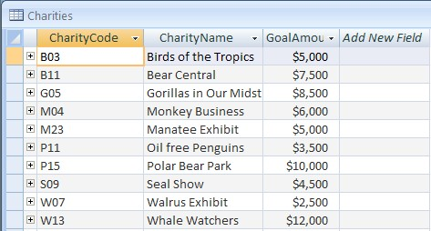
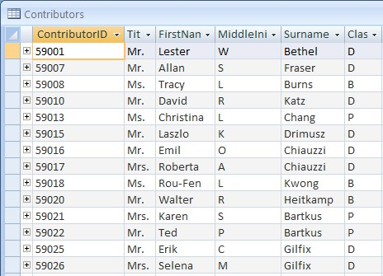
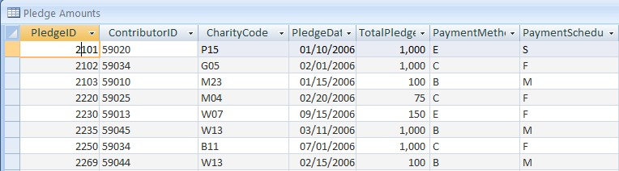
Database Functions using an example Tables, Primary keys and Foreign keys
Each Primary key in the table is unique e.g. Charities table’s primary key is CharityCode
The ContributorID and
CharityCode fields in the PledgeAmounts table is called the foreign key
Notes:
A database table is a sophisticated form of the Excel list – look similar, but has more substance behind the scenes.

Slide 16
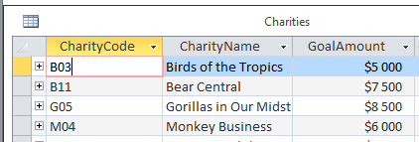
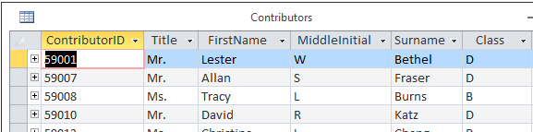
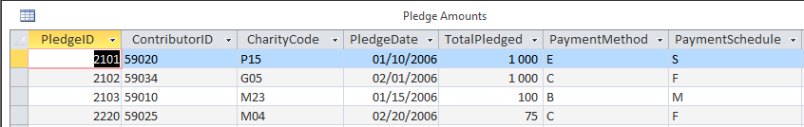
Database Functions using an example
Table relationships
Information is linked without duplication (e.g. phone number of contributor only stored once)
Table Relationships allows:
  query data from more than one table
  Extract data from multiple tables as if they were one

Slide 17
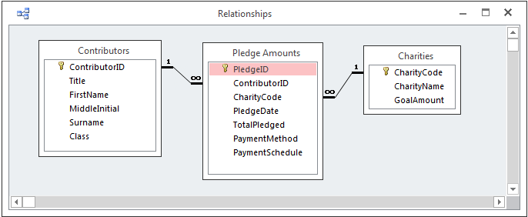
Database Functions using an example
Defining relationships
Relationships window
Drag and drop PK from the Primary table to the related table
Notes:
Three related tables, “one” side of relationship, “many” side of relationship, join line, primary key and primary table, foreign key in related table.

Slide 18
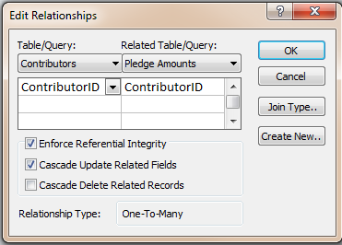
Database Functions using an example
Edit relationships
Double click on relationship line
Set properties
Notes:
You get to this window by clicking on the join line. The next slides addresses the tick-boxes

Slide 19
Database Functions using an example
Referential integrity
Maintains consistency between related tables when data is updated, as data in queries must be accurate and consistent
Referential Integrity ensures data consistency
  Adding records to related table
  Only allowed if matching record exists in Primary table
  For example: A new Pledge can only be entered if the specific CharityCode and ContibutorID already exist
Notes:
Referential integrity: set of rules to maintain consistency between related tables when data is updated.
You can add a record to related table only if matching record exists in primary table

Slide 20
Database Functions using an example
Referential integrity
Updating records
Changing value of Primary keys in Primary table
  Only allowed if no matching records exist in Related table
  BUT: If Cascade Updates was selected
    Matching records in Related table updated
Notes:
You can change a primary key in primary table only if there is no matching record in related table, unless cascade updates was chosen. This will cause matching values in related tables to be updated
Rules of deletion and updates when setting up your table Cascade (waterfall effect) to update/delete all other tables using that specific key

Slide 21
Database Functions using an example
Referential integrity
Deleting records
Deleting record in primary table
  Only allowed if no matching records exist in Related table
  BUT: If Cascade Deletes was selected
    Matching records in Related table also deleted
Notes:
You can delete a primary key in primary table only if there is no matching record in related table, unless cascade deletes was chosen. This will cause matching values in related tables to be deleted
Rules of deletion and updates when setting up your table Cascade (waterfall effect) to update/delete all other tables using that specific key

Slide 22
Database Functions using an example
Getting information from database
Filter
  Display records that satisfies single or multiple criteria
  Usually not saved for re-use
Form
  View a single record (can be used for adding records)
Report
  Built-in tools to create professional looking reports with ease
Query
  Extract data
  Perform calculations with data
  Summarize data
  Saved for re-use
  Can be created using different methods

Slide 23
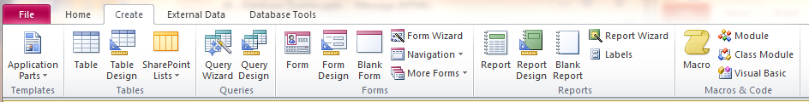
Database Functions using an example
Different Methods
Wizards to create basic
  Form, Query and Report
Design view to make changes
  Form, Query and Report
Query can also be done using SQL (SQL View)
Notes:
We will be focussing on the QBE - Query By Example - SQL will not be covered in this module

Slide 24
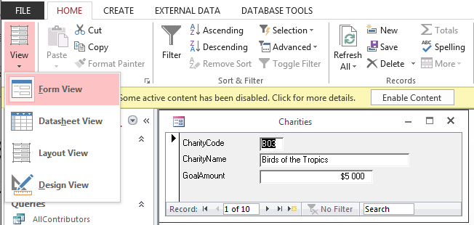
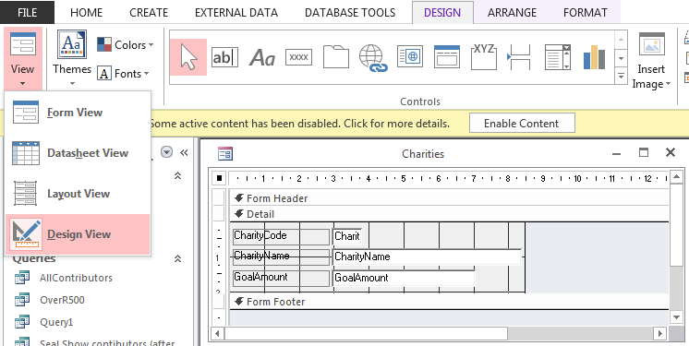
Database Functions using an example Working with Forms
Form view (result) and design view

Slide 25
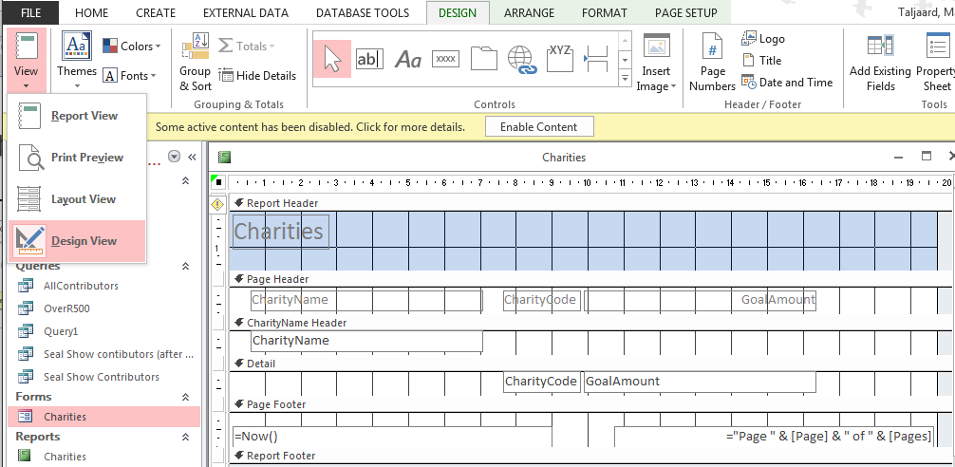
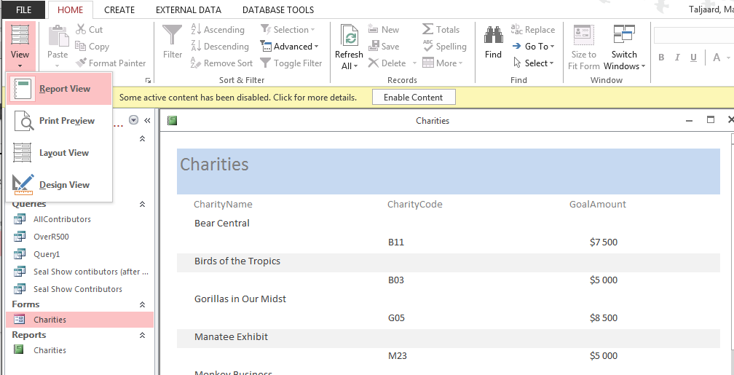
Database Functions using an example Working with Reports
Report view (result) and design view

Slide 26
Database Advantages
Databases make data more meaningful and useful
Databases turn data into information
Databases can prevent the following problems that often occur with lists:
  Data redundancy
  Data inconsistency
  Inappropriate data
  Incomplete data

Slide 27
Database Advantages
Manage large amounts of data efficiently
Make information
sharing possible
Data centralization – only one file is maintained
Promotes data integrity-data is accurate and reliable
Ensures data is organized efficiently

Slide 28
Database Disadvantages
Database systems are complex, difficult, and time-consuming to design.
Expensive hardware and software start-up costs.
Damage to database affects virtually all applications programs.
Initial training required for all programmers and users.

Slide 29
Example Questions for Assessments
Which of the following is a likely primary key in a student information record?
    Date of birth
    Student ID number
    Last name
    First name
Give two advantages of using a Database
Define the Database term Referential Integrity
Use your answers to complete the appropriate Moodle Weekly Test on this content and check what you have correct and what you need to correct!

Slide 30
Wrap-up
You interact with Databases daily, when you retrieve a friend’s phone number from your contacts, post to your Facebook page or add a song to your Spotify playlist. Databases provide relevant information quickly and easily.
Consult your lecturer if you have any problems or questions regarding this content.

